Slide 1



Infrared Communication
(Short-Range Wireless Technology)
Presented by:
Abdus Salam
IT-21016
Department of Information and Communication Technology
Mawlana Bhashani Science & Technology University,
Santosh, Tangail-1902.

Slide 2
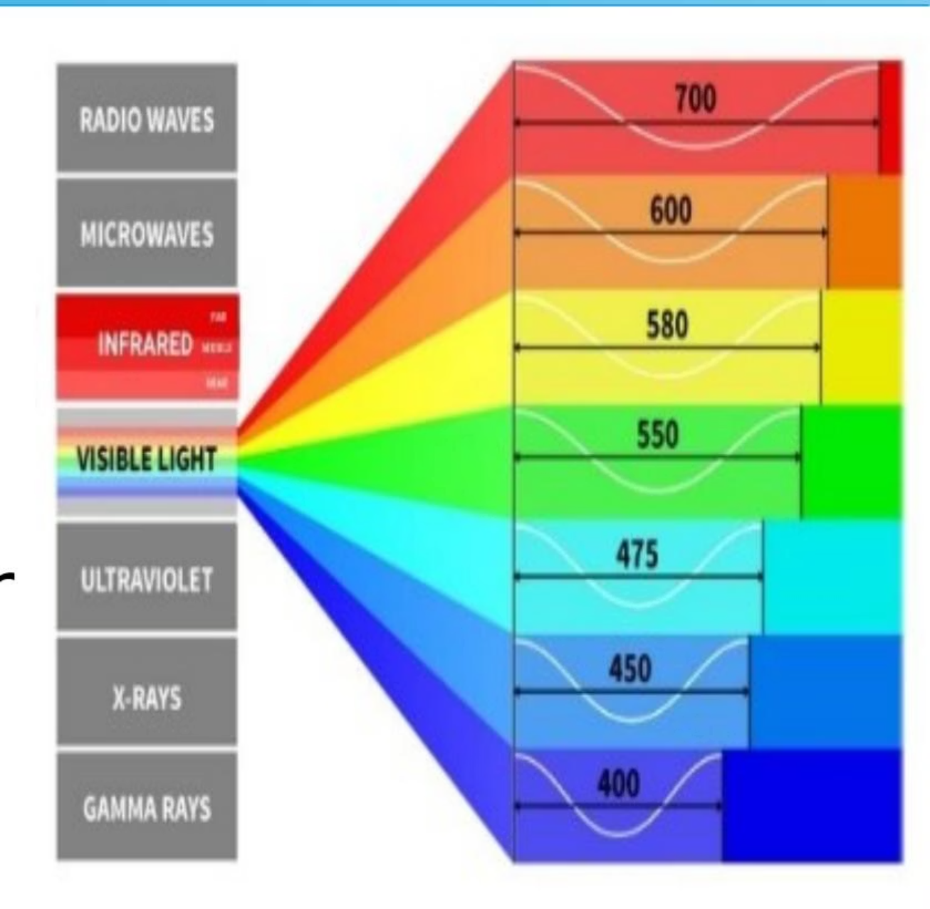
What is Infrared?
Electromagnetic Spectrum
Communication Range
Infrared means 'below red' with a wavelength of 700 nm to 1 mm.
Used for short-range, line-of-sight communication, like TV remotes.
Purpose
Developed as a low-cost, simple wireless alternative for device control.

Slide 3





The Basic Principle of IR Communication
Light Waves
Communication occurs through invisible infrared light waves.
Transmitter
An Infrared LED sends the signal.
Receiver
A photo-diode or phototransistor detects the signal.
Data Transmission
Data is sent as light pulses representing binary data.

Slide 4
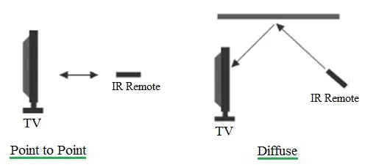

Three Types of Infrared Communication
Point-to-Point
Diffuse
Ir-DA Standard
Direct, line-of-sight communication between two devices (e.g., remote and TV).
Signals are reflected from walls or ceilings to reach the receiver.
High-speed data exchange protocol (older technology) for devices like laptops or phones.

Slide 5

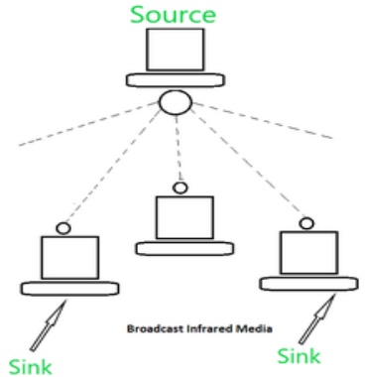
Key Characteristics of IR Technology
1-5m
16 Mbps
Low
High
Range
Data Rate
Power
Directionality
Short communication distance.
Maximum speed under the IrDA standard.
Low power consumption, making it battery friendly.
Requires a clear line-of-sight.

Slide 6

Advantages: Why IR Remains Relevant
Low Cost
Easy and inexpensive to implement in devices.
High Security
Cannot penetrate walls, limiting eavesdropping.
Low Power Usage
Efficient and friendly for battery-operated devices.
No Interference
Free from radio signal interference.

Slide 7

Disadvantages: Limitations of IR
Short Range
Limited communication distance (1–5 meters).
Line-of-Sight
Requires clear path; easily blocked by obstacles.
Light Sensitivity
Performance is affected by sunlight or bright indoor lights.
Slower Data Rate
Slower compared to modern standards like Wi-Fi or Bluetooth.

Slide 8
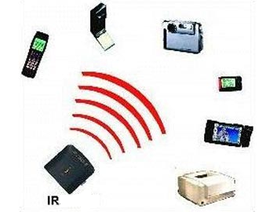
Diverse Applications of Infrared
Infrared technology is used across various sectors, from consumer electronics to
industrial systems.
Device Control
TVs, AC units, and projectors.
Sensing
Motion detectors and automatic doors.
Security
Intrusion detection systems.
Specialized Instruments
Industrial and medical equipment.

Slide 9
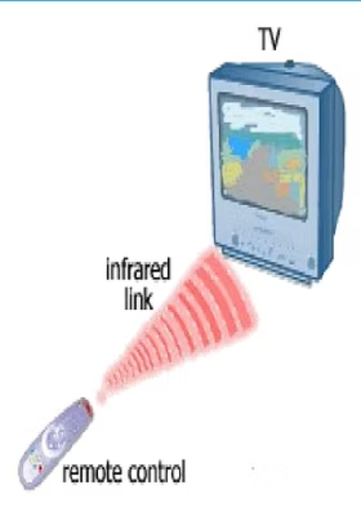
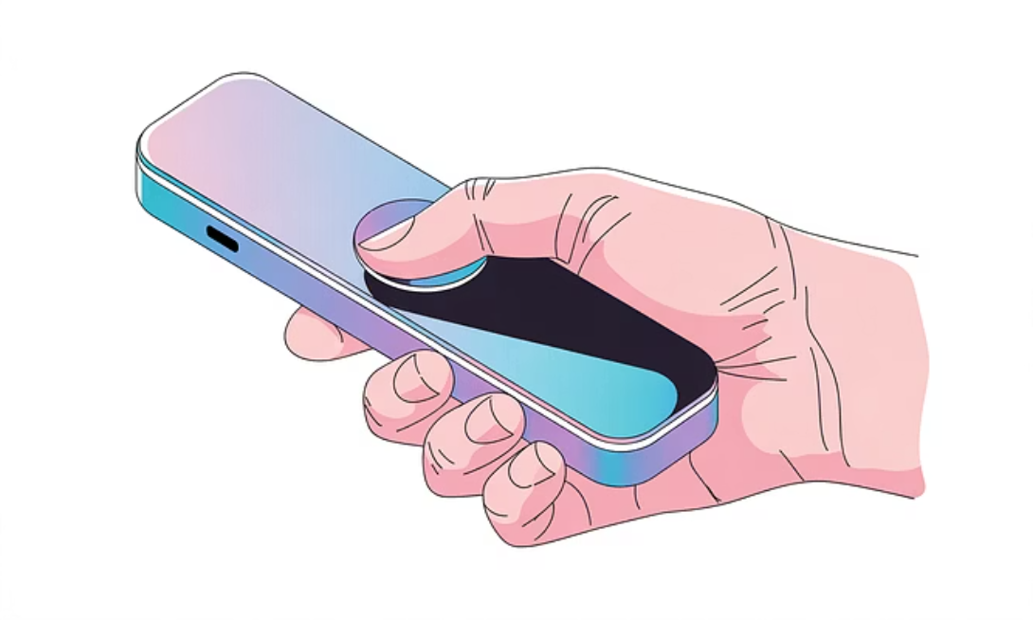

Case Study: The TV Remote Process
Button Press
Signal Transmission
Circuit generates the corresponding binary code.
IR LED sends modulated light pulses.
Signal Reception
Action Performed
TV receiver detects and decodes the signal.
TV executes the desired command (e.g., volume up).

Slide 10
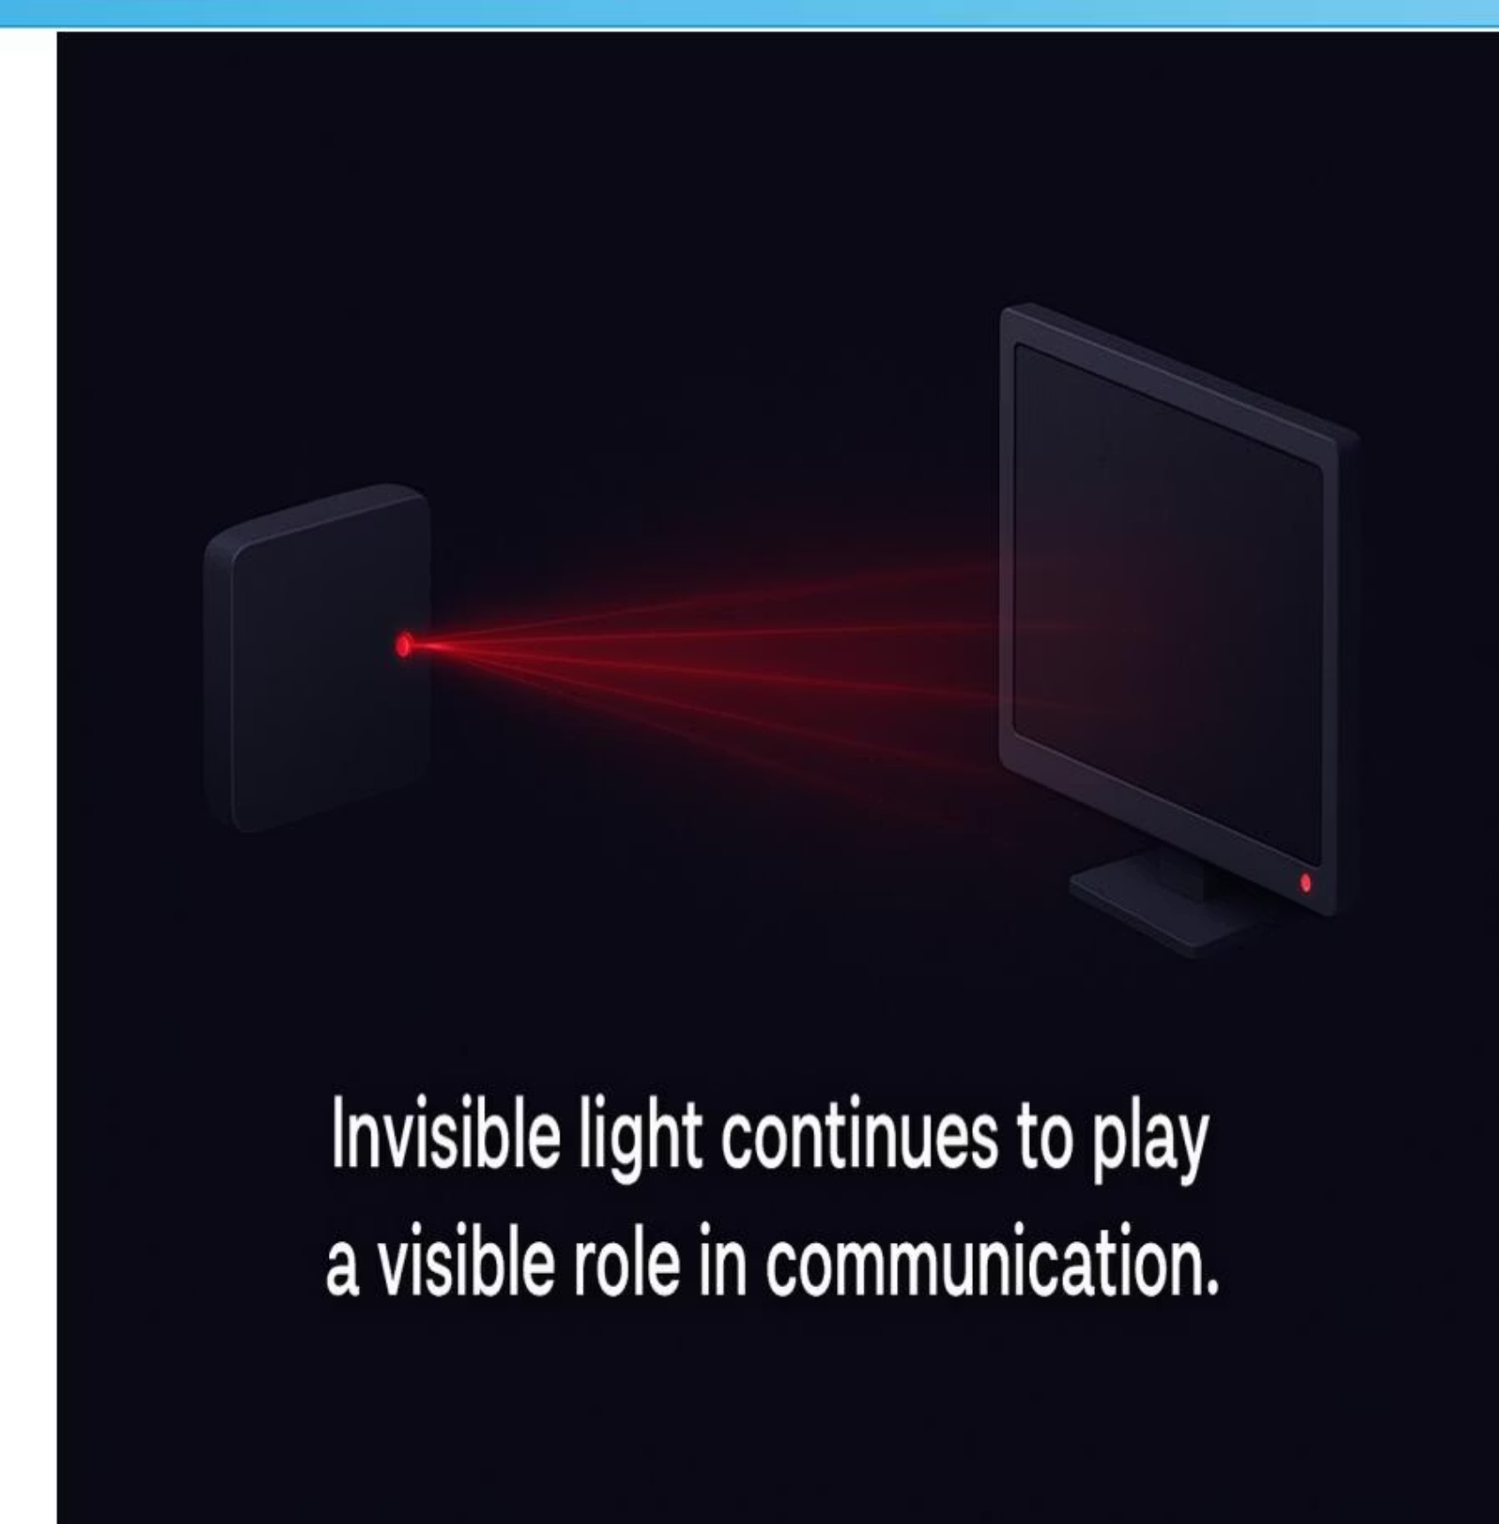
Conclusion: The Enduring Role of IR
Core Strengths
Secure, simple, and low-cost short-range communication.
Best Use Cases
Ideal for device control, sensor applications, and embedded systems.
Modern Relevance
Still vital in thermal imaging, robotics, and gesture control.
Invisible light continues to play a visible role in communication.
Invisible light continues to play a visible role in communication.

Slide 11


